Slide 1
Linked Lists

Slide 2
Disadvantages of arrays
It is relatively expensive to insert and delete elements in an array.
Also since in an array usually occupies a block of memory space, one cannot simply double or triple the size of an array when additional space os required.
For this reason arrays are called as dense lists.

Slide 3
Linked Lists
A linked list is a linear collection of data elements, called nodes, where the linear order is given by means of pointers.
Each node is divided into two parts:
  The first part contains the information of the element and
  The second part contains the address of the next node (link /next pointer field) in the list.

Slide 4
Linked list
  Connected by pointer links
  Accessed via a pointer to the first node of the list
  Link pointer in the last node is set to null to mark the list’s end
Use a linked list instead of an array when
  You have an unpredictable number of data elements
  You want to insert and delete quickly.

Slide 5
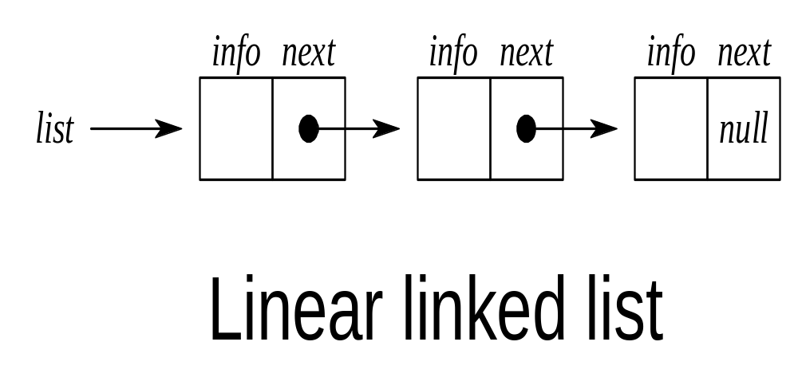

Slide 6
Representation of linked lists in memory
LIST requires 2 linear arrays – INFO and LINK such that INFO[K] and LINK[K] contain, resp., the information part and the nextpointer field of a node of LIST. LIST also requires a variable name such as START, which contains the location of the beginning of the list, and a nextpointer sentinel denoted by NULL – which indicates the end of the list.

Slide 7
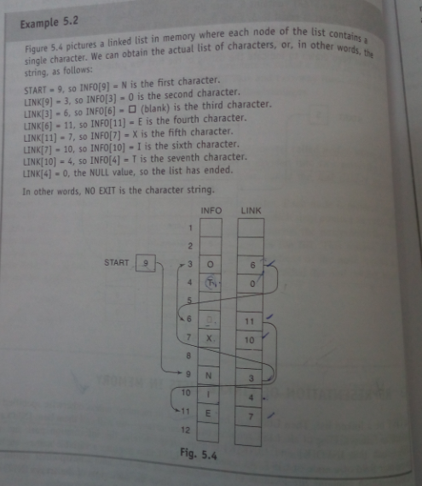

Slide 8
Traversing a linked List
  Let LIST be a linked list in memory. This algorithm traverses list, applying an operation PROCESS to each element of LIST. The variable PTR points to the node currently being processed.
  Set PTR := START. [Initializes pointer PTR.]
  Repeat Steps 3 and 4 while PTR != NULL.
  Apply PROCESS to INFO[PTR].
  Set PTR := LINK[PTR]. [PTR now points to the next node.]
  [End of Step 2 loop.]
  5. Exit.

Slide 9
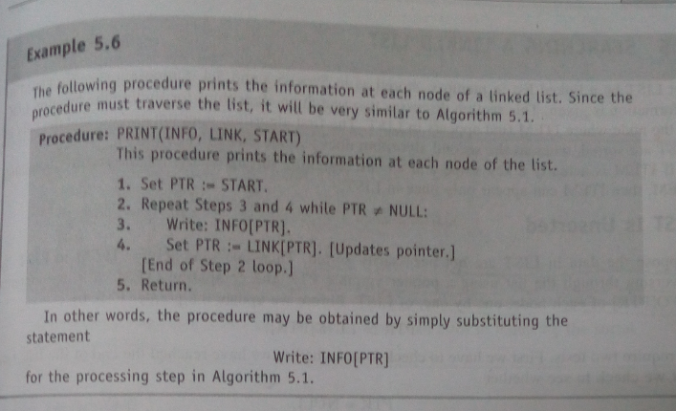
Print the elements

Slide 10
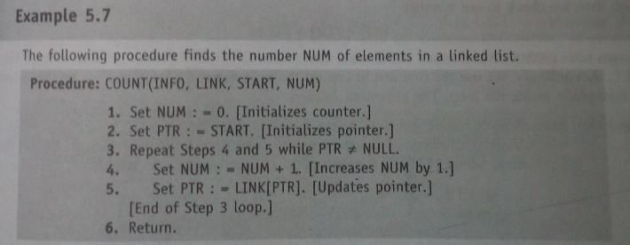
Count the number of elements

Slide 11
Searching a linked list (LIST is unsorted)
SEARCH(INFO, LINK, START, ITEM, LOC)
LIST is a linked list in memory. This algo finds the location LOC of the node where ITEM first appears in the LIST, or sets LOC = NULL.
1. Set PTR := START.
2. Repeat Step 3 while PTR != NULL:
  If ITEM = INFO[PTR], then:
Set LOC := PTR, and Exit.
Else:
Set PTR := LINK[PTR]. [PTR now points to the next node.]
[End of If structure.]
[End of Step 2 loop.]
4. [Search is unsuccessful.] Set LOC := NULL.
5. Exit.

Slide 12
Searching a linked list (LIST is sorted)
SEARCH(INFO, LINK, START, ITEM, LOC)
LIST is a sorted list in memory. This algorithm finds the location LOC of the node where
ITEM first appears in the LIST, or sets LOC = NULL.
1. Set PTR := START.
2. Repeat Step 3 while PTR != NULL:
3. If ITEM > INFO[PTR], then:
    Set PTR := LINK[PTR]. [PTR now points to the next node.]
    Else if ITEM = INFO[PTR], then:
Set LOC := PTR, and Exit. [Search is successful.]
Else:
Set LOC := NULL, and Exit. [ITEM now exceeds INFO[PTR].]
[End of If structure.]
[End of Step 2 loop.]
4. [Search is unsuccessful.] Set LOC := NULL.
5. Exit.

Slide 13
Overflow and underflow
Sometimes new data are to be inserted into the data structure but there is no available space, i.e., the free storage list is empty.This situation is called as overflow.
Observe that overflow will occur with linked lists when AVAIL=NULL.
Underflow on the other hand occurs when one wants to delete the data from data structure that is empty.

Slide 14
Insertion at the beginning
INSFIRST (INFO, LINK, START, AVAIL, ITEM)
[OVERFLOW?] If AVAIL = NULL, then: Write: OVERFLOW, and Exit.
[Remove first node from AVAIL list]
Set NEW= AVAIL and AVAIL= LINK [AVAIL].
Set INFO [NEW] = ITEM. [Copy the new data to the node].
Set LINK [NEW] = START. [New node points to the original first node].
Set START = NEW. [START points to the new node.]
EXIT.

Slide 15
Insertion Algorithm (After a given node)
INSLOC (INFO, LINK, START, AVAIL, LOC, ITEM)
[OVERFLOW?] If AVAIL = NULL, then: Write: OVERFLOW, and Exit.
[Remove first node from AVAIL list]
Set NEW= AVAIL and AVAIL= LINK [AVAIL].
Set INFO [NEW] = ITEM. [Copy the new data to the node].
If LOC = NULL, then: [Insert as a first node]
Set LINK [NEW] = START and START = NEW.
Else: [Insert after node with location LOC.]
Set LINK [NEW] = LINK [LOC] and LINK [LOC] = NEW.
[End of If structure.]
Exit.

Slide 16
Insertion into a sorted Linked List
If ITEM is to be inserted into a sorted linked list. Then ITEM must be inserted between nodes A and B such that:
INFO [A] < ITEM < INFO [B]
First of all find the location of Node A
Then insert the node after Node A.
INSERT (INFO, LINK, START, AVAIL, ITEM)
CALL FIND_A (INFO, LINK, START, AVAIL, ITEM)
[USE Algorithm FIND_A to find the location of node preceding ITEM.]
CALL INSLOC (INFO, LINK, START, AVAIL, LOC, ITEM)
[Insert ITEM after a given node with location LOC.]
Exit.

Slide 17
FIND_A (INFO, LINK, START, ITEM, LOC)
[List Empty?] If START = NULL, then: Set LOC = NULL, and Return.
[Special Case?] If ITEM < INFO [START], then: Set LOC = NULL, and Return.
Set SAVE = START and PTR = LINK [START]. [Initializes pointers]
Repeat step 5 and 6 while PTR ≠ NULL.
If ITEM < INFO [PTR] then:
Set LOC = SAVE, and Return.
[End of If Structure.]
Set SAVE = PTR and PTR = LINK [PTR]. [Update pointers]
[End of Step 4 Loop.]
Set LOC = SAVE.
Return.

Slide 18
Deleting a node from the linked list
DEL(INFO, LINK, START, LOC, LOCP)
This algorithm deletes the node N with location LOC. LOCP is the location of the node which precedes N, or when N is the first node, LOCP = NULL.
If LOCP = NULL, then:
Set START := LINK[START]. [Deletes first node.]
  Else:
  Set LINK[LOCP] := LINK[LOC]. [Deletes node N.]
  [End of If structure.]
2. [Free memory occupied by the deleted node.]
  FREE[N].
3. Exit.

Slide 19
Deleting the node with a given item of information
Procedure 1: FIND(INFO, LINK, START, ITEM, LOC, LOCP)
This procedure finds the location LOCP of the node preceding N. If ITEM does not appear in the list, then the procedure sets LOC = NULL; and if ITEM appears in the first node, then it sets LOCP = NULL.
1. [List empty?] If START = NULL, then:
Set LOC := NULL and LOCP := NULL, and Return.
[End of If structure.]
2. [ITEM in first node?] If INFO[START] = ITEM, then:
Set LOC := START and LOCP = NULL, and Return.
[End of If structure.]
3. Set SAVE := START and PTR := LINK[START]. [Initializes pointers.]
4. Repeat Steps 5 and 6 while PTR != NULL.
5. If INFO[PTR] = ITEM, then:
Set LOC := PTR and LOCP := SAVE, and Return.
[End of If structure.]
6. Set SAVE := PTR and PTR := LINK[PTR]. [Update pointers.]
[End of Step 4 loop.]
7. Set LOC := NULL.
8. Return.

Slide 20
DELETE(INFO, LINK, START, ITEM)
This algorithm deletes from a linked list the first node N which contains the given ITEM of information.
1. [Use Procedure 1 to find the location N and its preceding node.]
Call FIND(INFO, LINK, START, ITEM, LOC, LOCP)
2. If LOC = NULL, then: Write: ITEM is not in the list, and Exit.
3. [Delete node.]
If LOCP = NULL, then:
Set START := LINK[START]. [Deletes first node.]
Else
Set LINK[LOCP] := LINK[LOC].
[End of If structure.]
4. [Free memory from the deleted node.]
FREE[LOC].
5. Exit.

Slide 21
Header Linked Lists
Header linked list is a linked list which always contains a special node called the Header Node, at the beginning of the list.
It has two types:
a) Grounded Header List
Last Node Contains the NULL Pointer.
b) Circular Header List
Last Node Points Back to the Header Node.

Slide 22
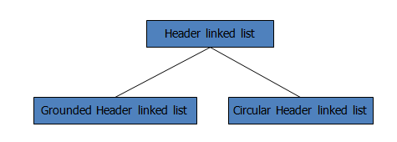

Slide 23
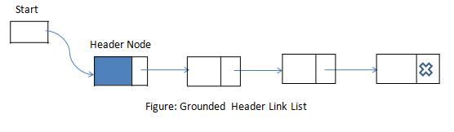
Grounded Header Linked List

Slide 24
Circular Header Linked List
A circular header linked list is a header list where the last node points back to the header node.
START always points to the header node.
LINK[START] = NULL means grounded header list is empty.
LINK[START] = START indicates that a circular header list is empty.

Slide 25
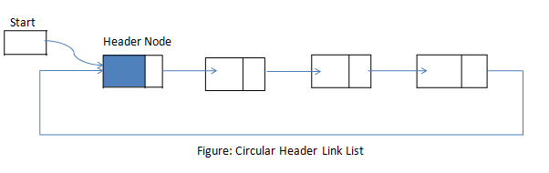

Slide 26
Benefits of using Circular Header List
The null pointer is not used, and hence pointers contain valid addresses.
Every (ordinary) node has a predecessor, so the first node may not require a special case.

Slide 27
Traversing a Circular Header List
  Let LIST be a circular header list in memory. This algorithm traverses list, applying an operation PROCESS to each element of LIST. The variable PTR points to the node currently being processed.
  Set PTR := LINK[START]. [Initializes pointer PTR.]
  Repeat Steps 3 and 4 while PTR != START.
  Apply PROCESS to INFO[PTR].
  Set PTR := LINK[PTR]. [PTR now points to the next node.]
  [End of Step 2 loop.]
  5. Exit.

Slide 28
Note that,
LINK[START]=NULL indicates that grounded header list is empty, and LINK[START]=START indicates that a circular header list is empty.

Slide 29
Advantages of header linked list
Header linked list contains a special node at the top.
This header node need not represent the same type of data that succeeding nodes do.
It can have data like, number of nodes, any other data...
Header node can access the data of all the nodes in the linked list.

Slide 30
Use of header linked list
Header Linked lists are frequently used for maintaining Polynomials in memory.

Slide 31
Two-Way Lists
A two-way list is a linear collection of data elements, called nodes, where each node N is divided into three parts:
  Information field
  Forward Link which points to the next node
  Backward Link which points to the previous node
The starting address or the address of first node is stored in START / FIRST pointer .
Another pointer can be used to traverse list from end. This pointer is called END or LAST.

Slide 32
Every node (except the last node) contains the address of the next node, and every node (except the first node) contains the address of the previous node.
A two-way list (doubly linked list) can be traversed in either direction.

Slide 33
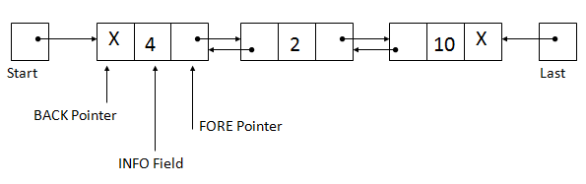
Representation of
Two-way lists

Slide 34
Insertion in 2 way lists
INSTwl(info, forw, back, start, avail, locA, locB, item)
[Overflow?] If avail = null, then
Write: Overflow and Exit
//[Remove node from avail list and copy new data into node]
Set new = avail, avail = forw[avail], info[new] = item
//[Insert node into list]
Set forw[locA] = new, forw[new] = locB
back[locB] = new, back[new] = locA
4. Exit.

Slide 35
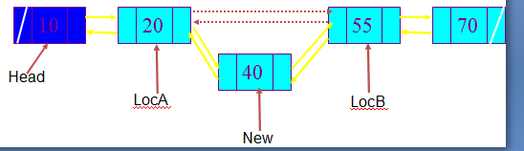

Slide 36
Deletion in 2 way lists
DelTwl(info, forw, back, start, avail, loc)
[Delete node]
Set forw[ back[loc] ] = forw[loc] and
back[ forw[loc] ] = back[loc]
[Return node to avail list]
Set forw[loc] = avail and avail = loc
3. Exit

Slide 37
